Slide 1
Computing Research Project for including Digitalization in Remote working System
Module Project
Module: Computing Research Project
Course: : Computing Research Project by doing digitalization for Remote Workers in Business .
Start Date :
End Date :
Submission Date: 11/12/2023
Learner Name: Nethmi Nilupulie
Enrollment ID: Presentation Date:

Slide 2
Document History
Version Number | Effective Date of release | Summary of Included Changes | Author
1 | 6th August 2021 | First Edition | Student Name

Slide 3

1. Project Definition
Project Background: brief out the scenario
Jumpstart, a prominent retail chain with 750 nationwide locations, faced challenges in adapting to the new era of remote work post-Covid 19. To prioritize customer needs, they reached out to Aceadora Tech for a solution. The tech team created a corresponding e-commerce website for Jumpstart, focusing on project planning, research, design, and implementation. The website caters to men, women, and children, offering essential clothing items. It provides a user-friendly platform for online shopping, allowing users and administrators to easily manage product details, carts, checkout, and orders.
Project Goal:
Increasing traffic from social media.
Creating More Compelling Content.
Better Use of Email Marketing.
Improved Shopping Cart Abandonment Rates.
Increased Conversion Rates.
Increased Customer Satisfaction.
Improved Retention/Loyalty Among Customers.

Slide 4

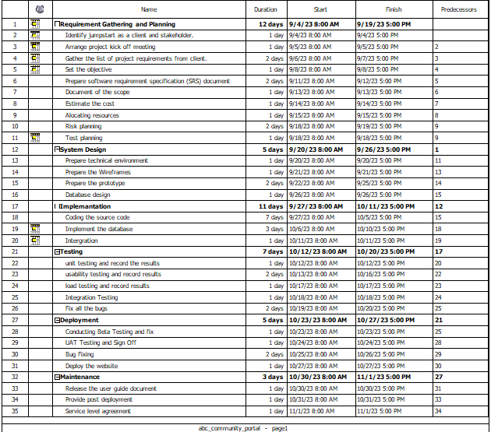
2. Project Deliverables
Project Deliverables:
Project Plan

Slide 5
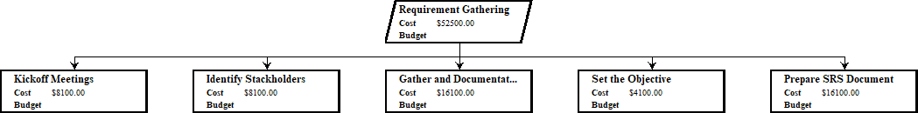
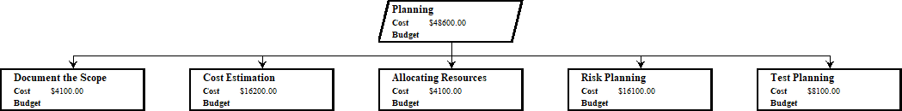
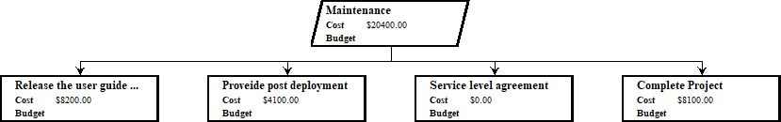
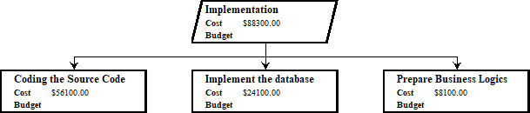
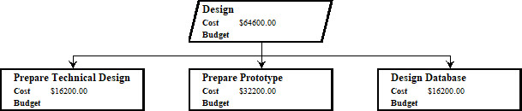
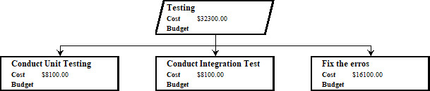
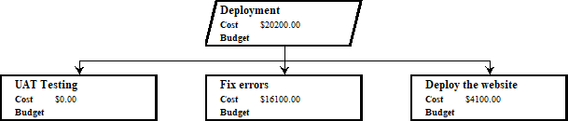
2. Project Deliverables
Project Deliverables: WBS
2
3
4
7
5

Slide 6
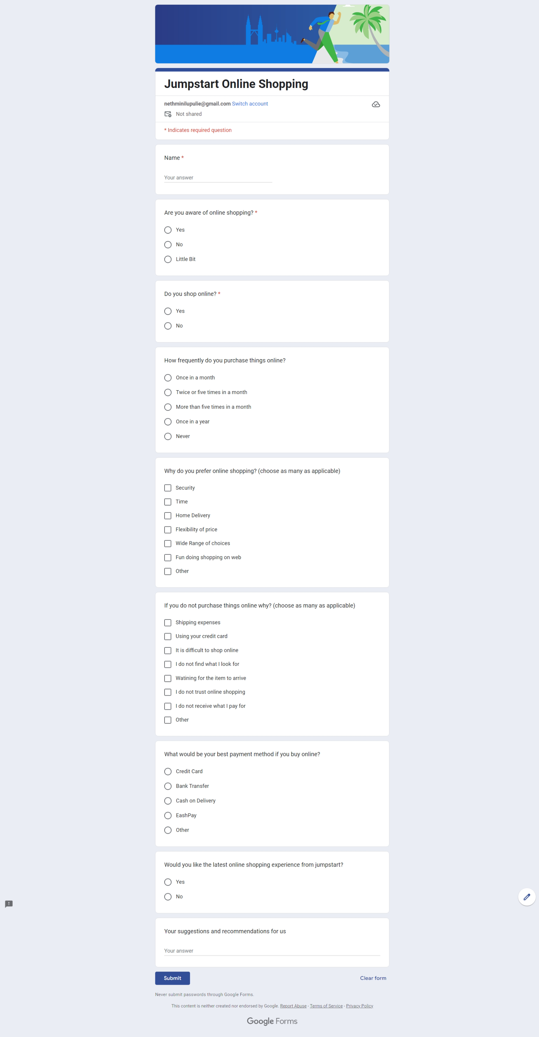
2. Project Deliverables
Project Deliverables:
Pre Implementation Survey
https://forms.gle/R29BFDH216aTdmRj6

Slide 7
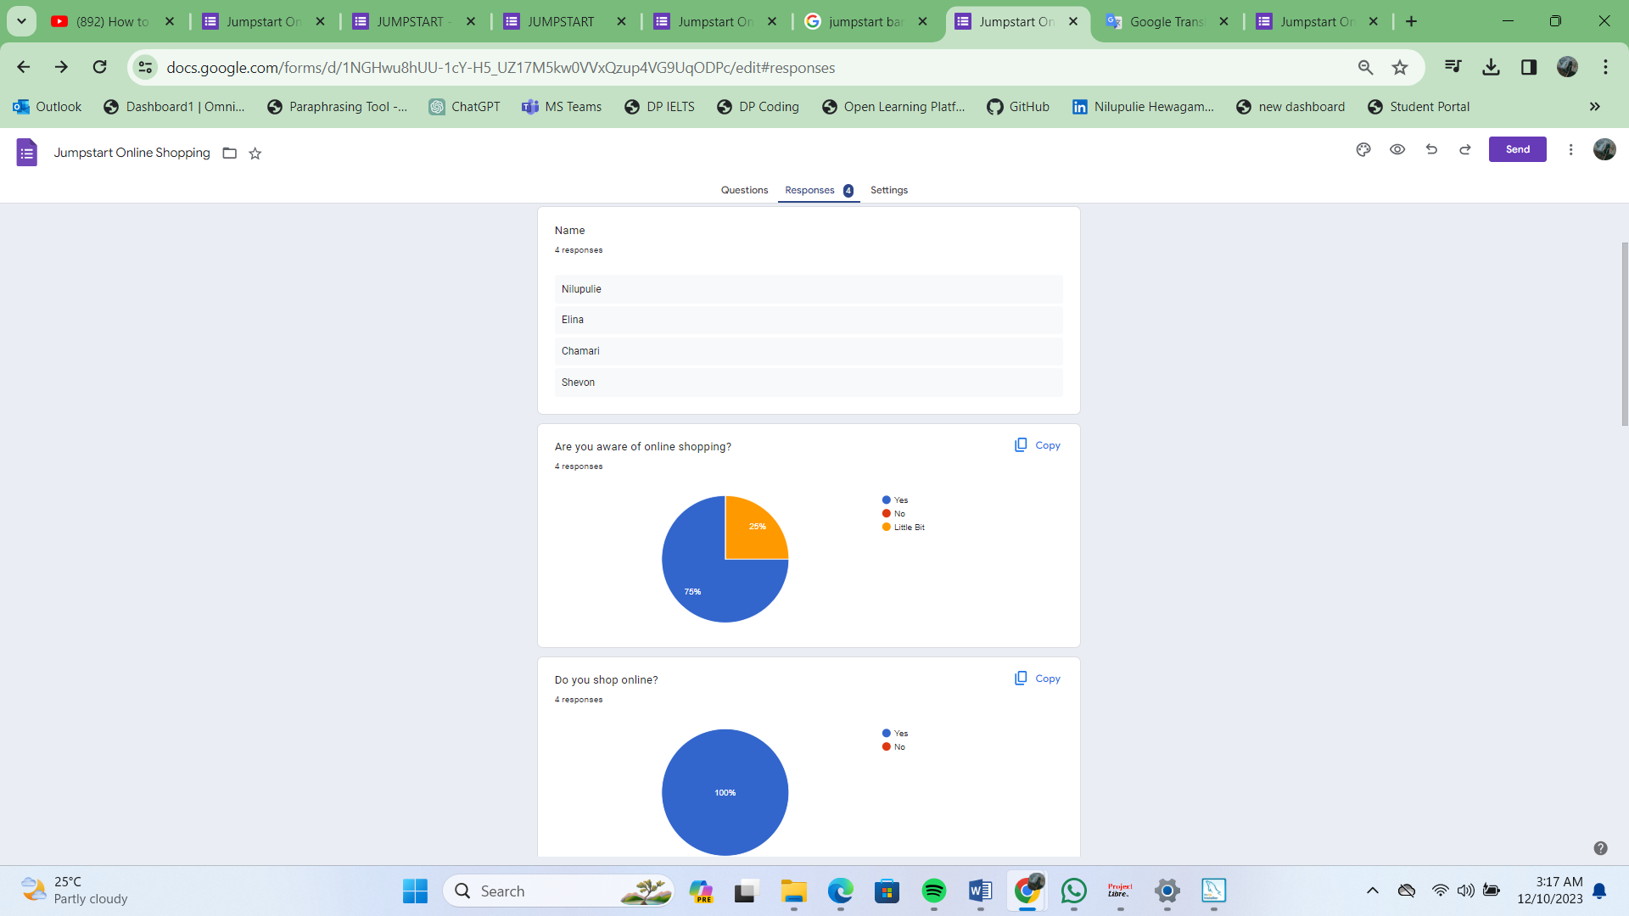
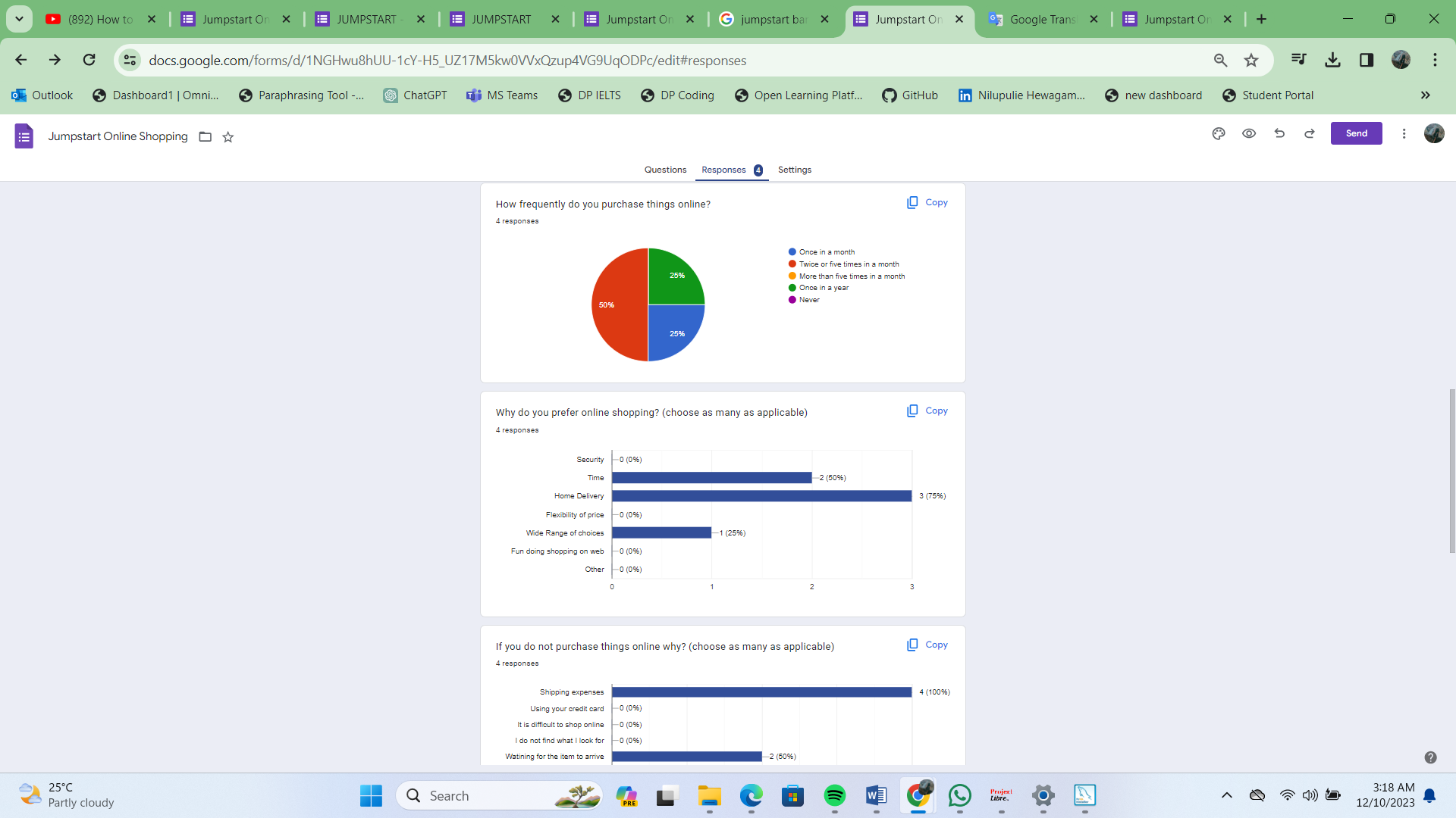
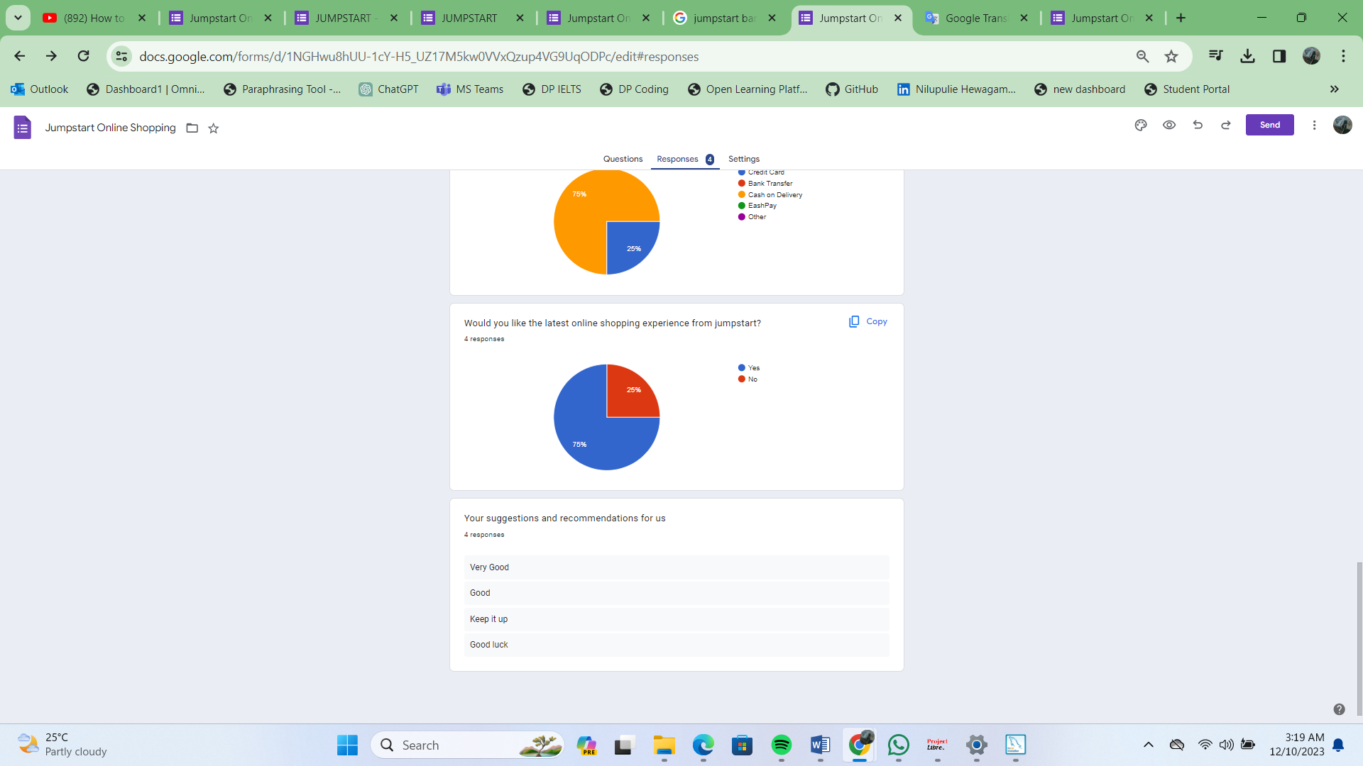
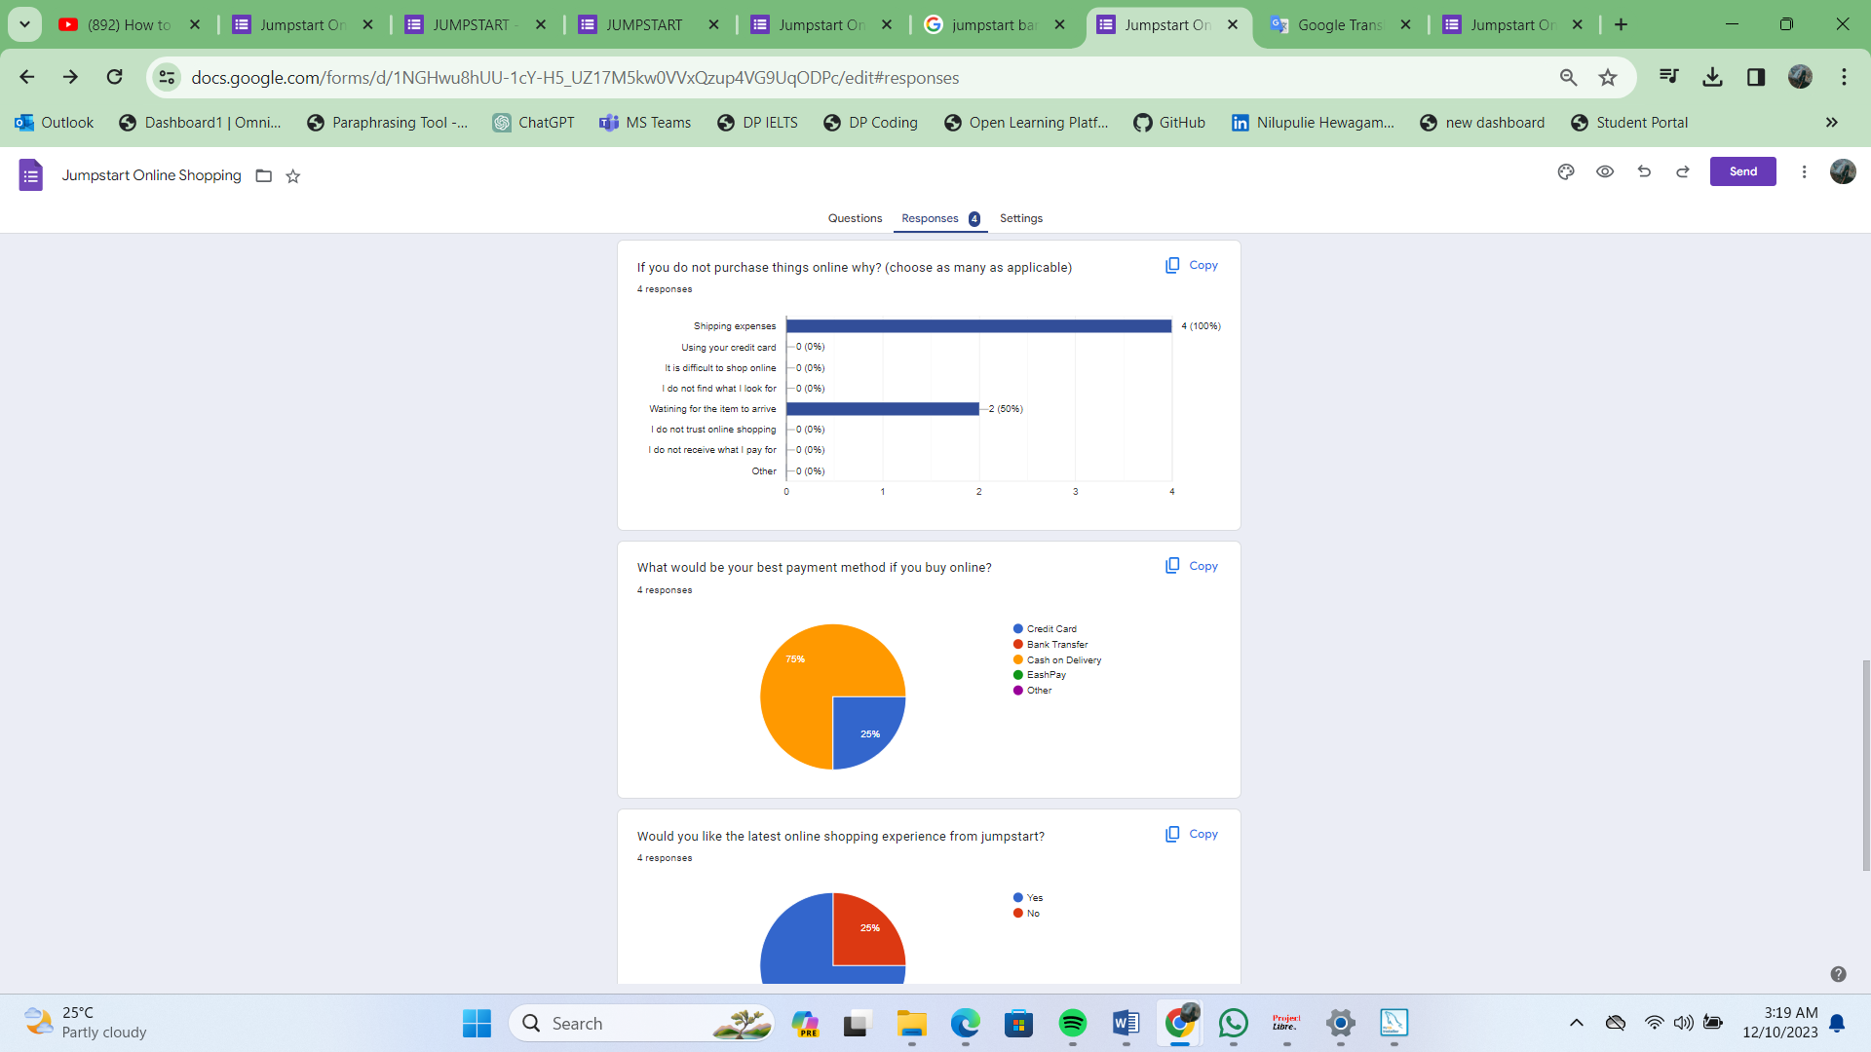
2. Project Deliverables
Project Deliverables:
Pre Implementation Survey - Responses

Slide 8
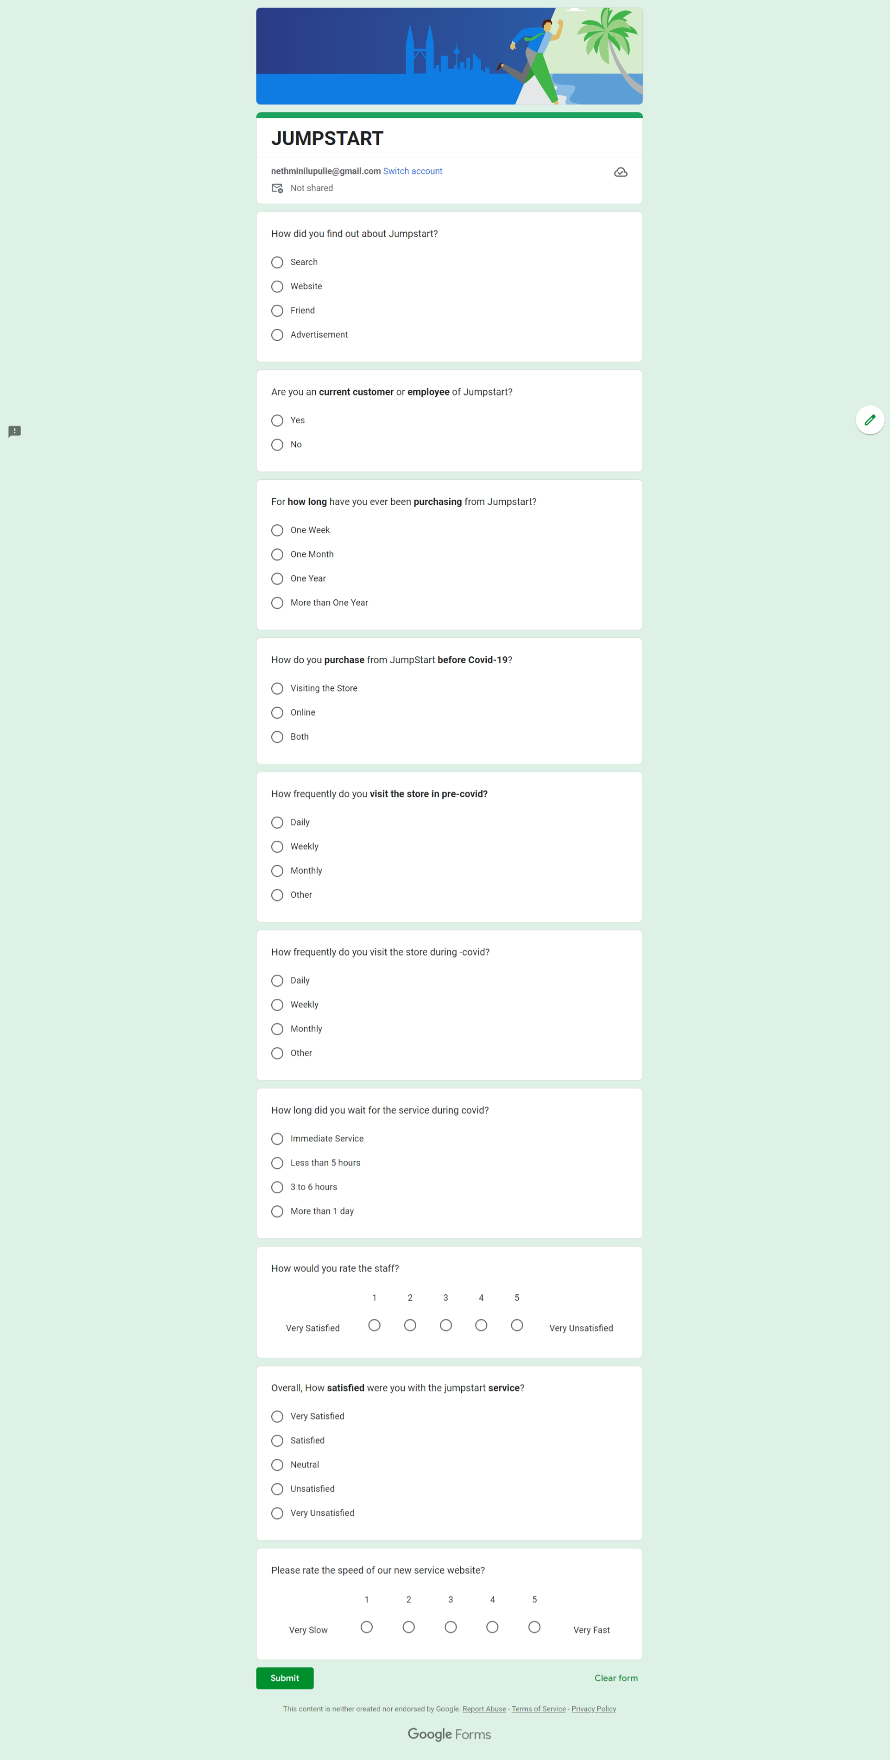
2. Project Deliverables
Post Implementation Survey
https://forms.gle/WcDUrSLFyebnePsA9

Slide 9
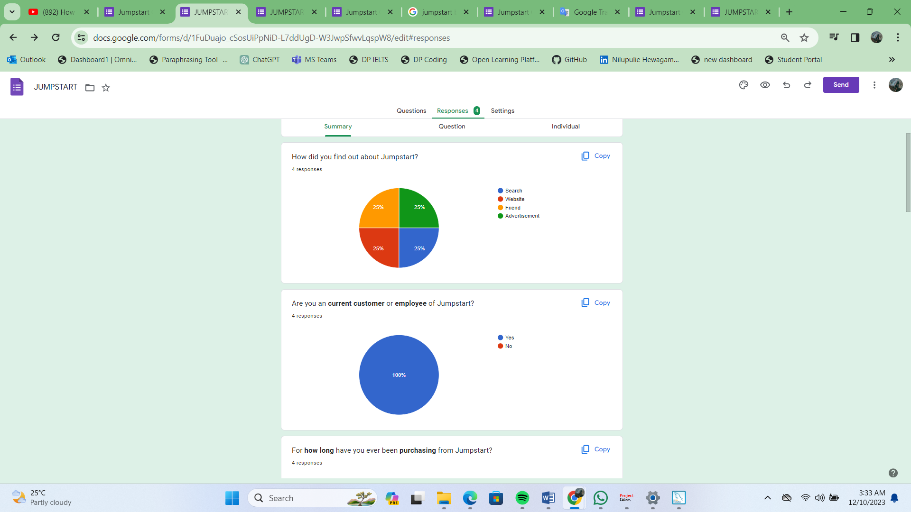
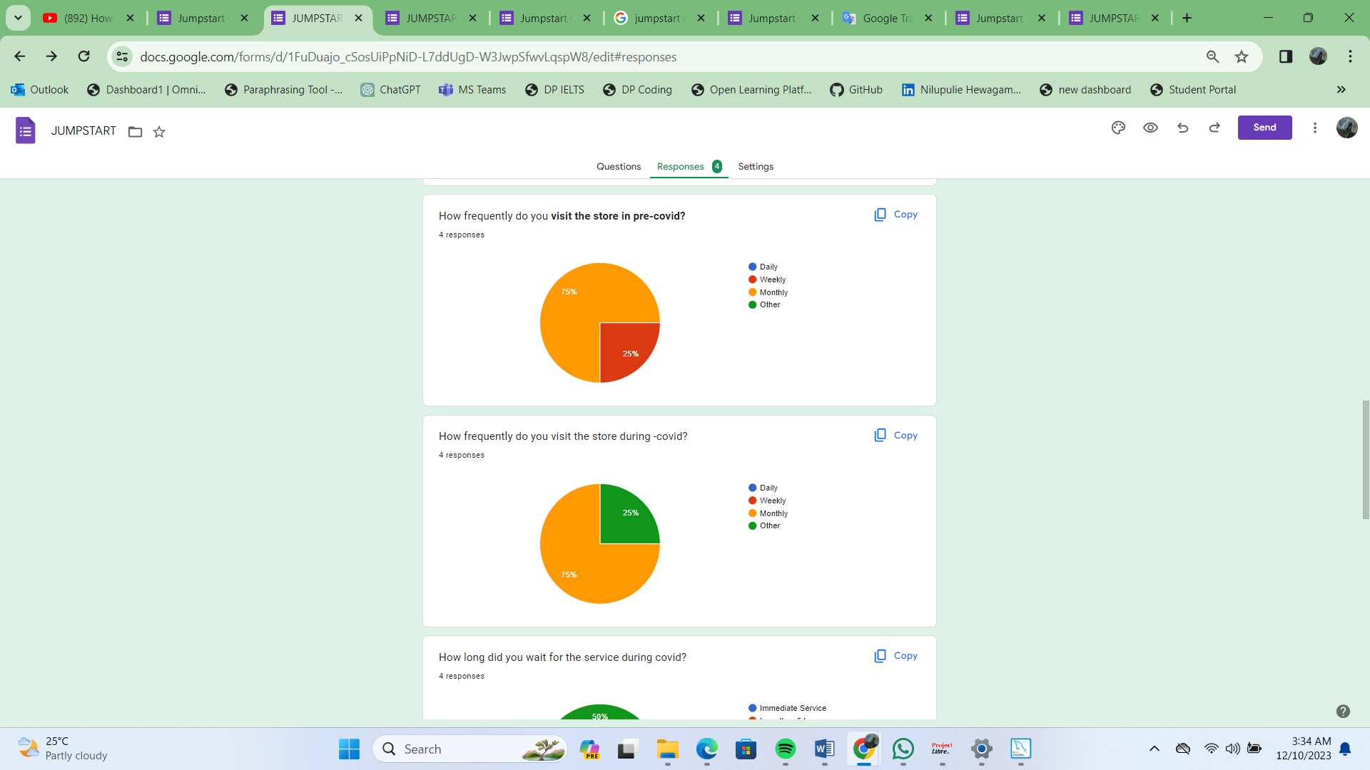
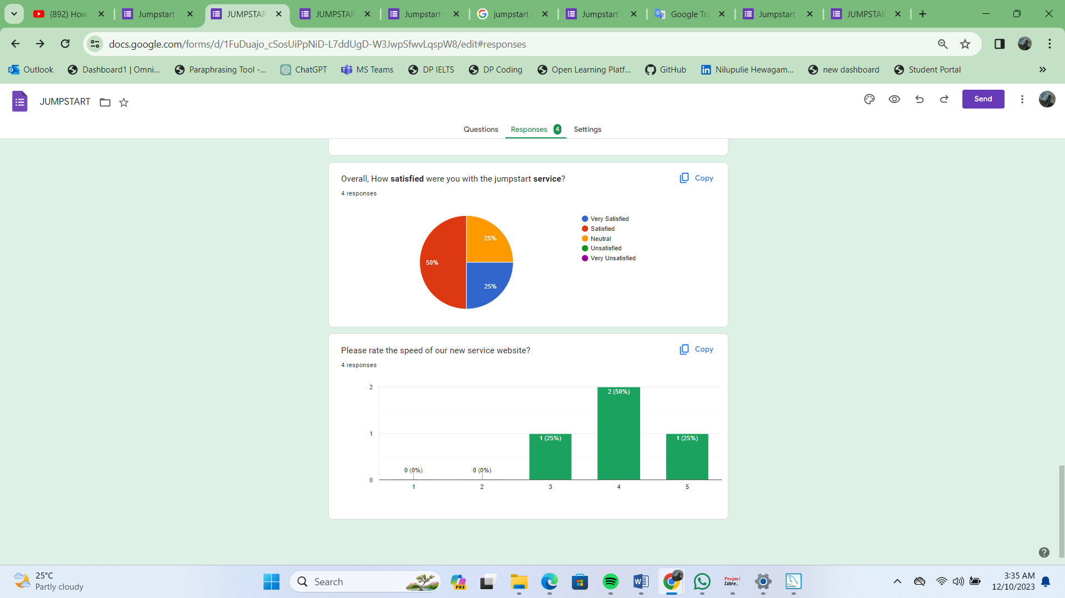
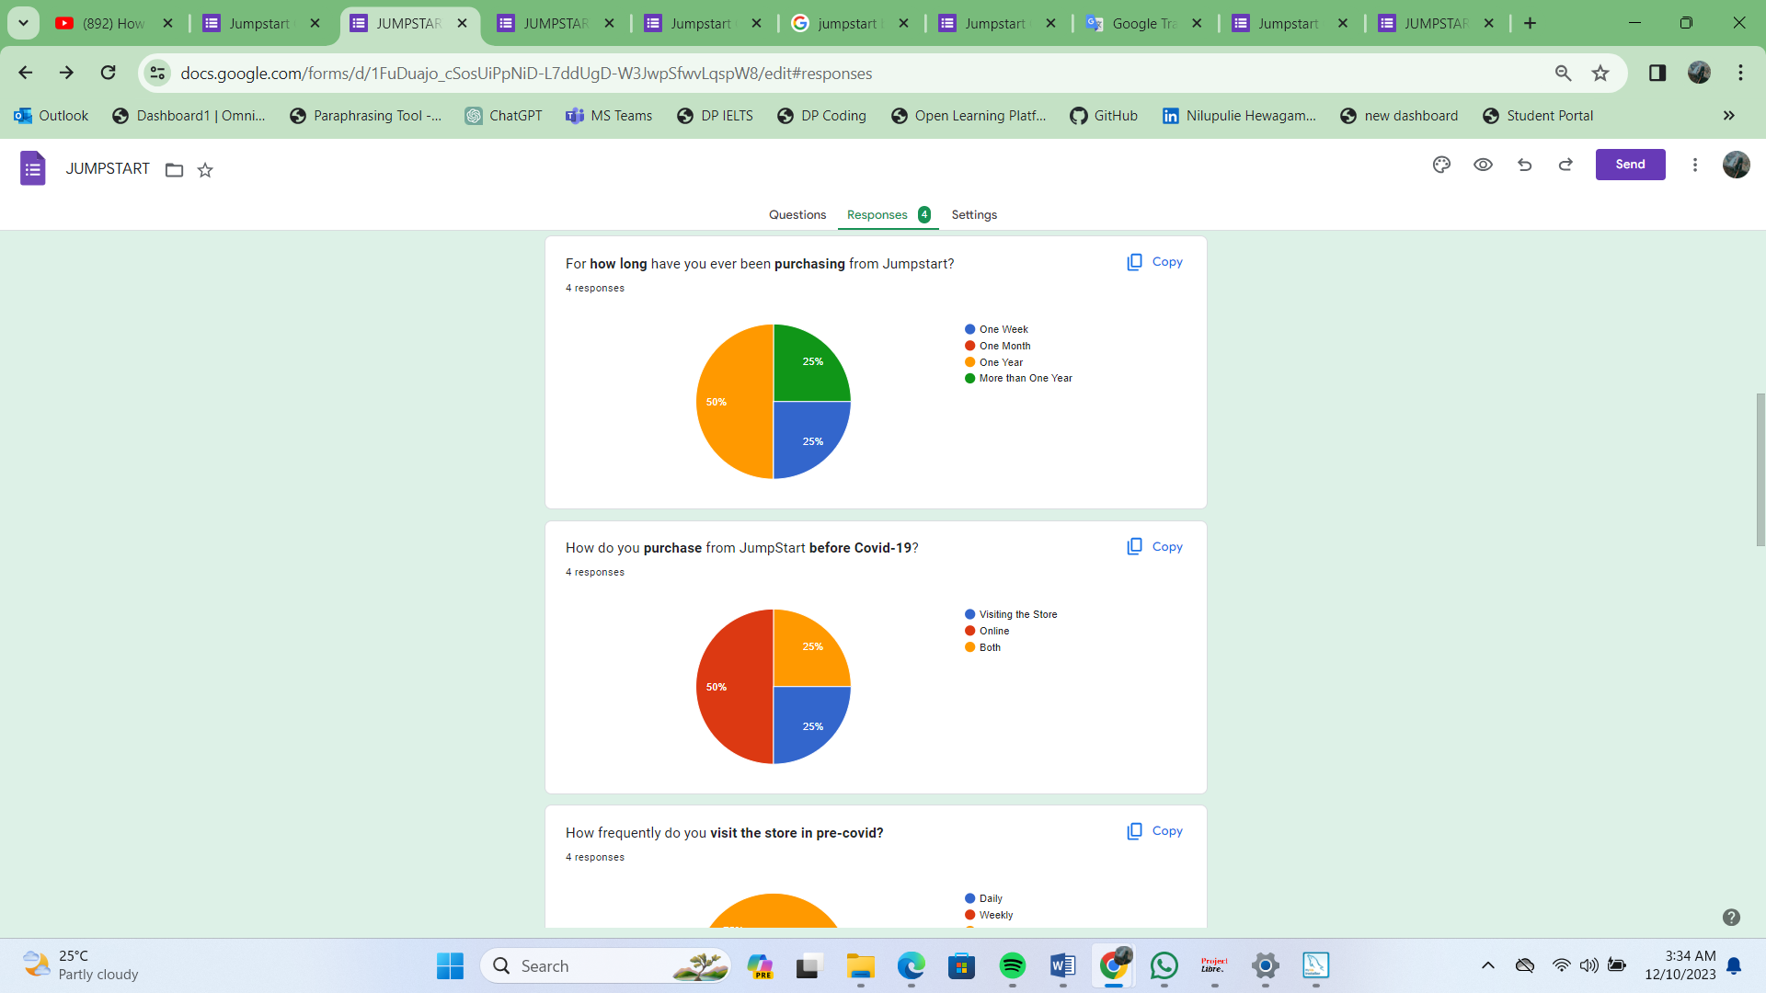
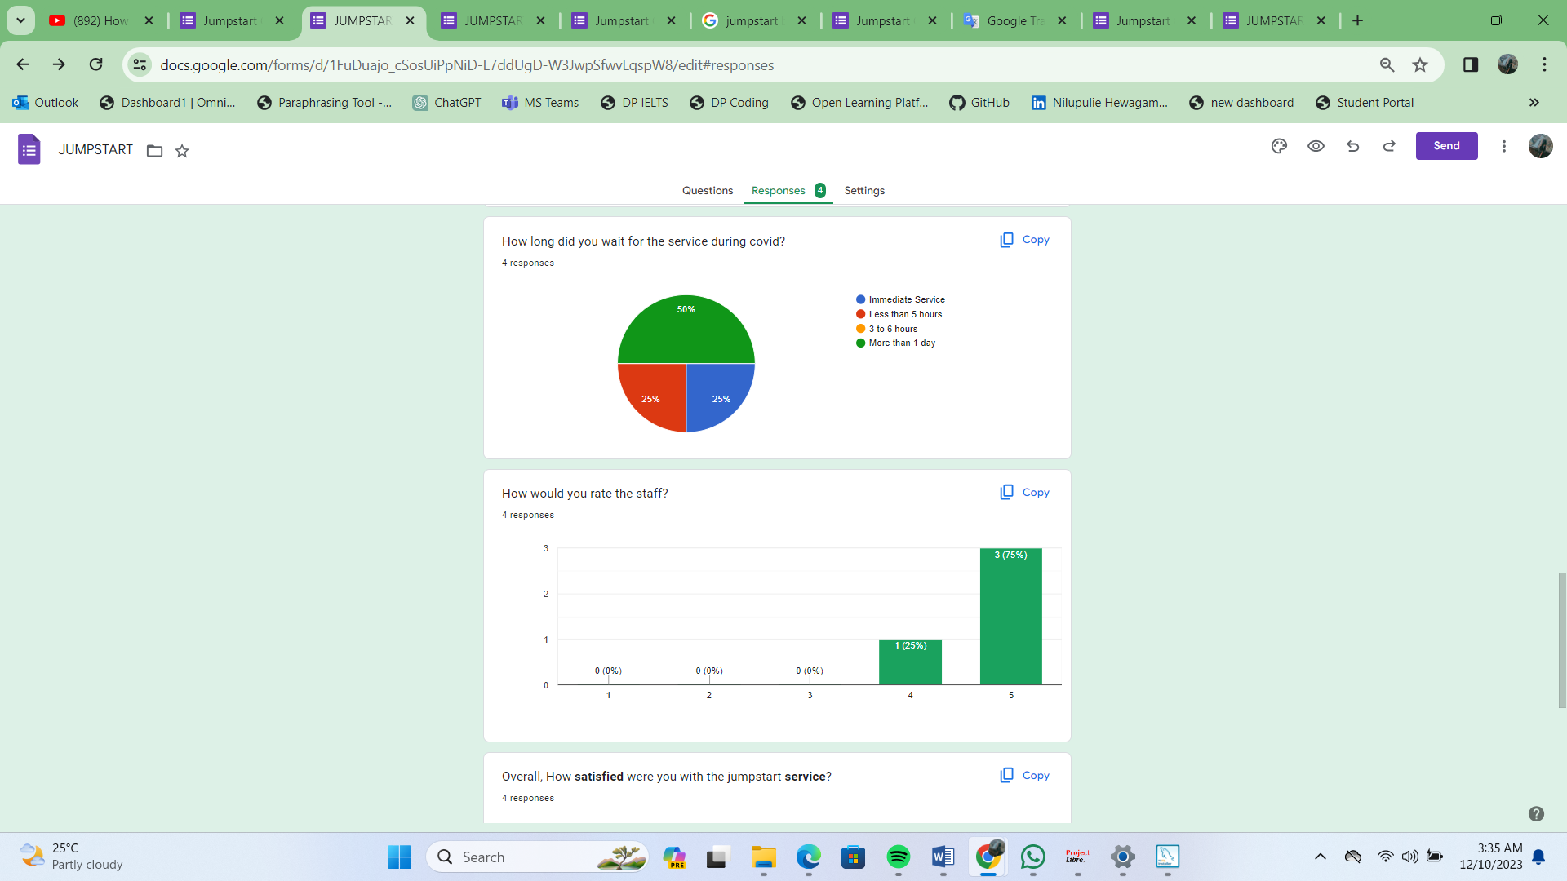
2. Project Deliverables
Post Implementation Survey - Responses

Slide 10
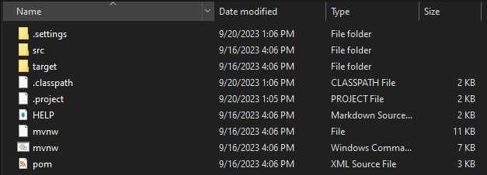
2. Project Deliverables
List of Evidences
Screenshots of the project directory

Slide 11
3. Project Milestones & Tasks
Project Task ID | Project Task Description | Project Milestone ID
1 | Conduct Survey For information Gathering | 1
2 | Prepare Research Proposal template | 1
3 | Prepare Work Breakdown Structure | 1
4 | Create Gantt Chart using Project Libre | 2
5 | Compare and Evaluate Project Solution by doing Research | 2
6 | Conduct Survey for Jumpstart Opinion on Recommended Solution | 2
7 | Setup the Development Environment based on the Technical Development Environment | 2
8 | Project Report detailing the Technical Design | 3
9 | Develop the UI standard pages | 3
10 | Create common Struts Includes, Models, Views & Controllers | 3
11 | Develop Classes | 3
12 | Develop Test Cases | 3
13 | Develop Project Documentation | 3
14 | Develop User Manual | 3

Slide 12
4. Project Environment
Technical Environment and Tools Used
Spring Tool Suite (STS) 4
MySQL Workbench 8.0 CE
Axure RP 10
Project Libre
Draw.io
Microsoft Word
Microsot PowerPoint
Microsoft Excel
Google Form
List of references
https://dist.springsource.com/release/STS/index.html
https://dev.mysql.com/downloads/workbench/
https://www.axure.com/download
https://sourceforge.net/projects/projectlibre/
Login.png - diagrams.net
https://docs.google.com/forms/d/1x4p8mLV4o_wsV2lJxxJyfpIl3I46ZLSm6fTS6321cao/edi
t?pli=1

Slide 13

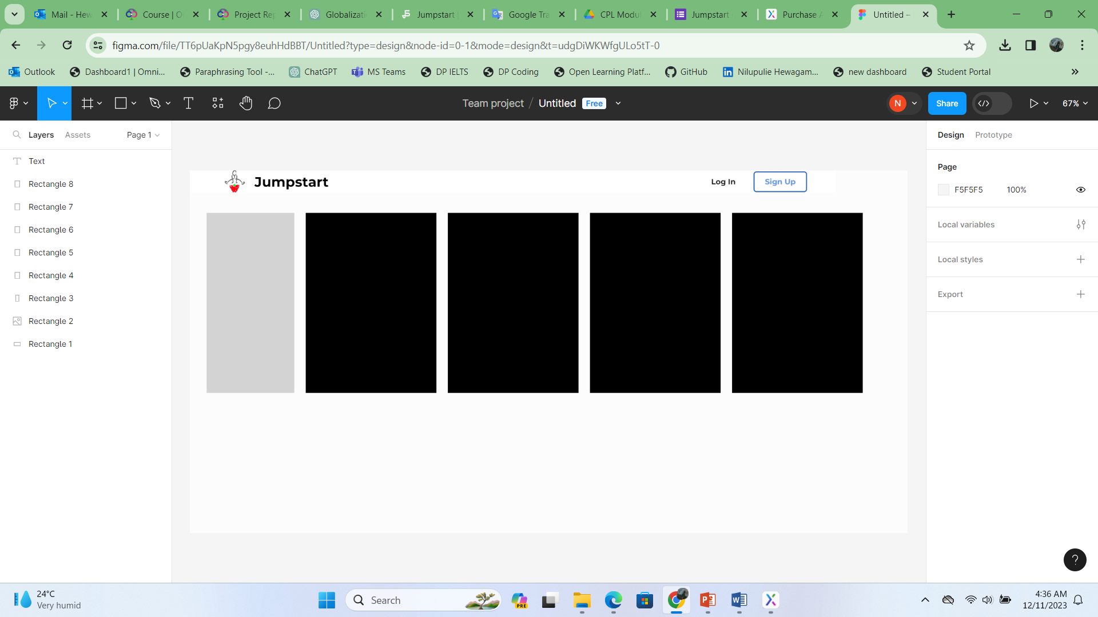
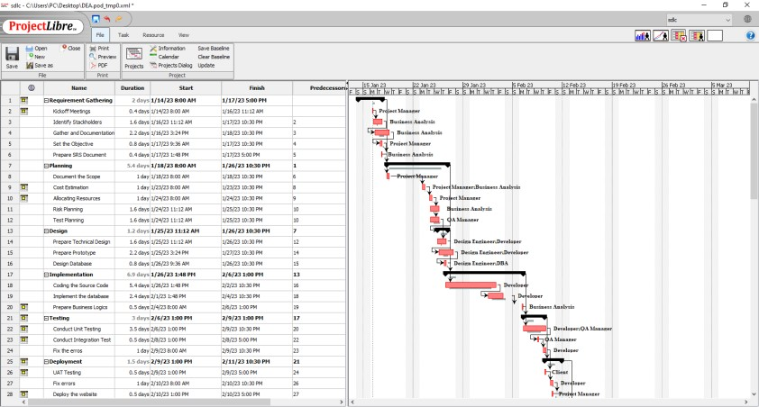


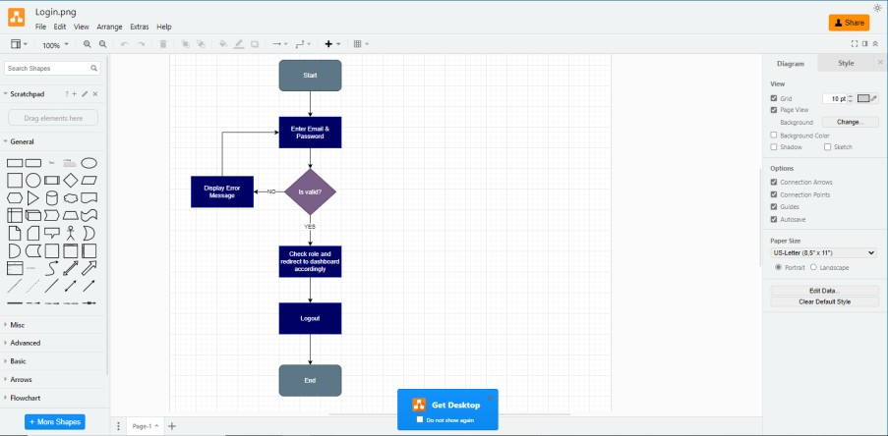
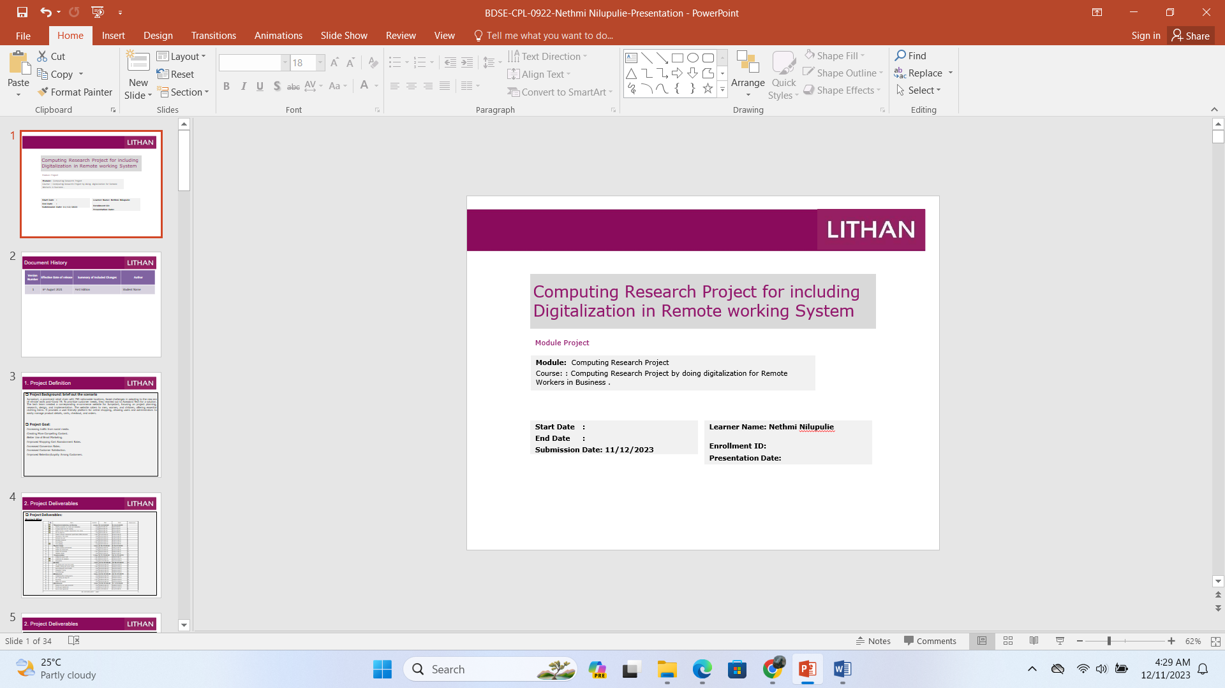
5. Tools
Tools & Platforms Used
Figma
Project Libre
Diagram.net
Microsoft Power Point

Slide 14


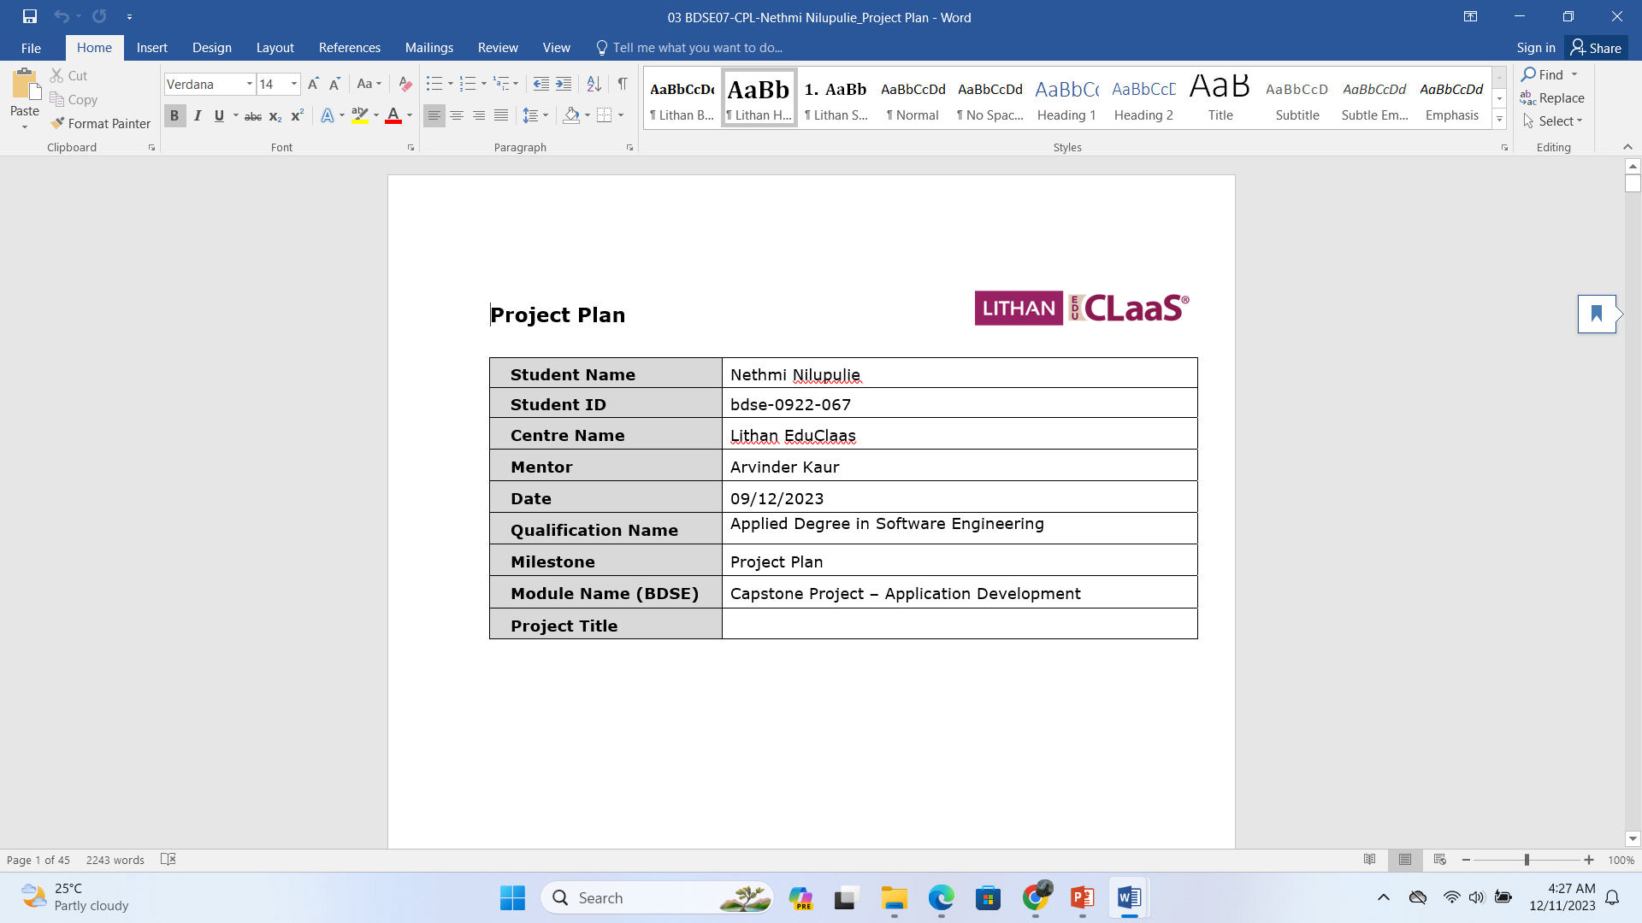
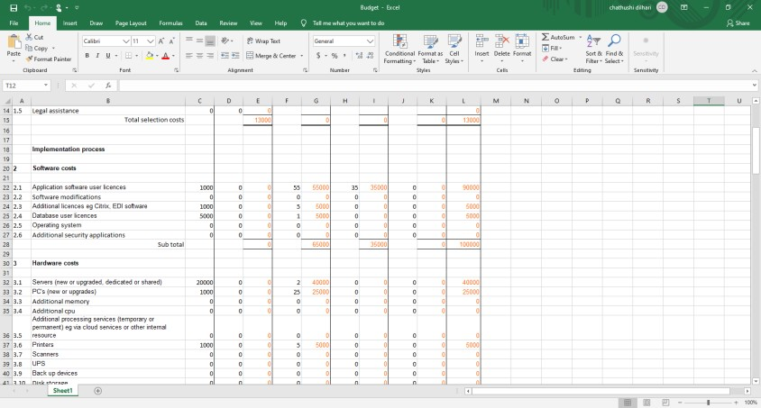


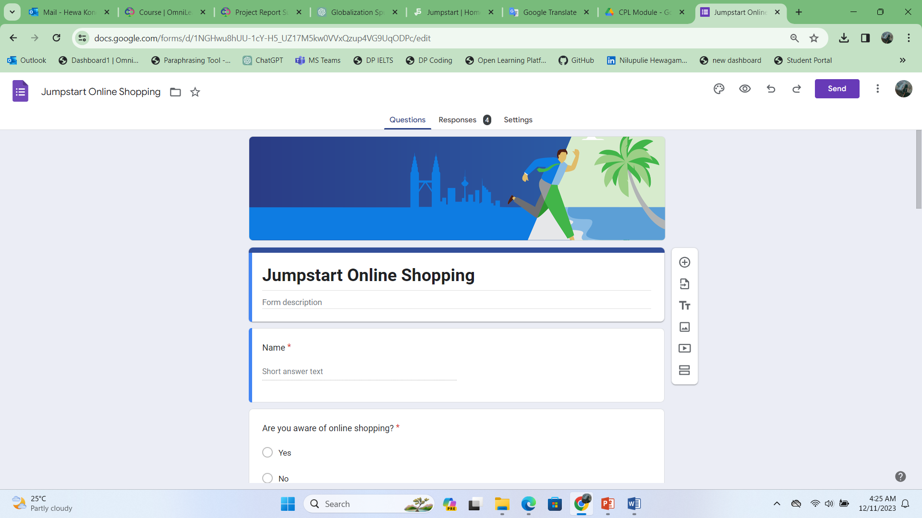
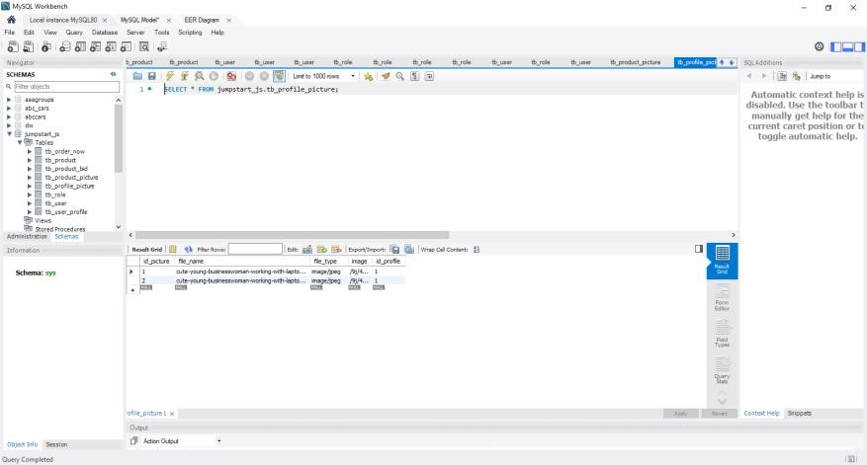
5. Tools
Tools & Platforms Used
Microsoft Word
Microsoft Excel
Google Form
MySQL Workbench

Slide 15

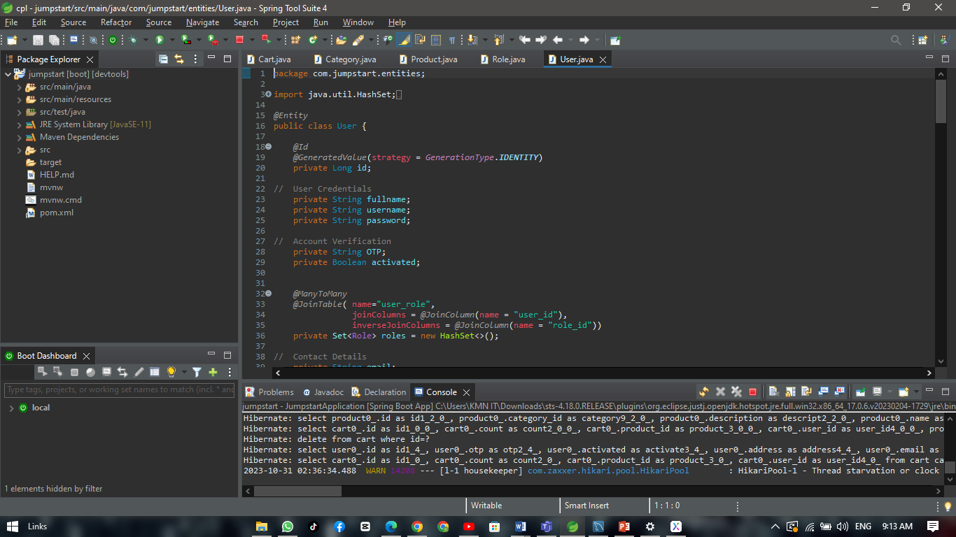
5. Tools
Tools & Platforms Used
STS

Slide 16
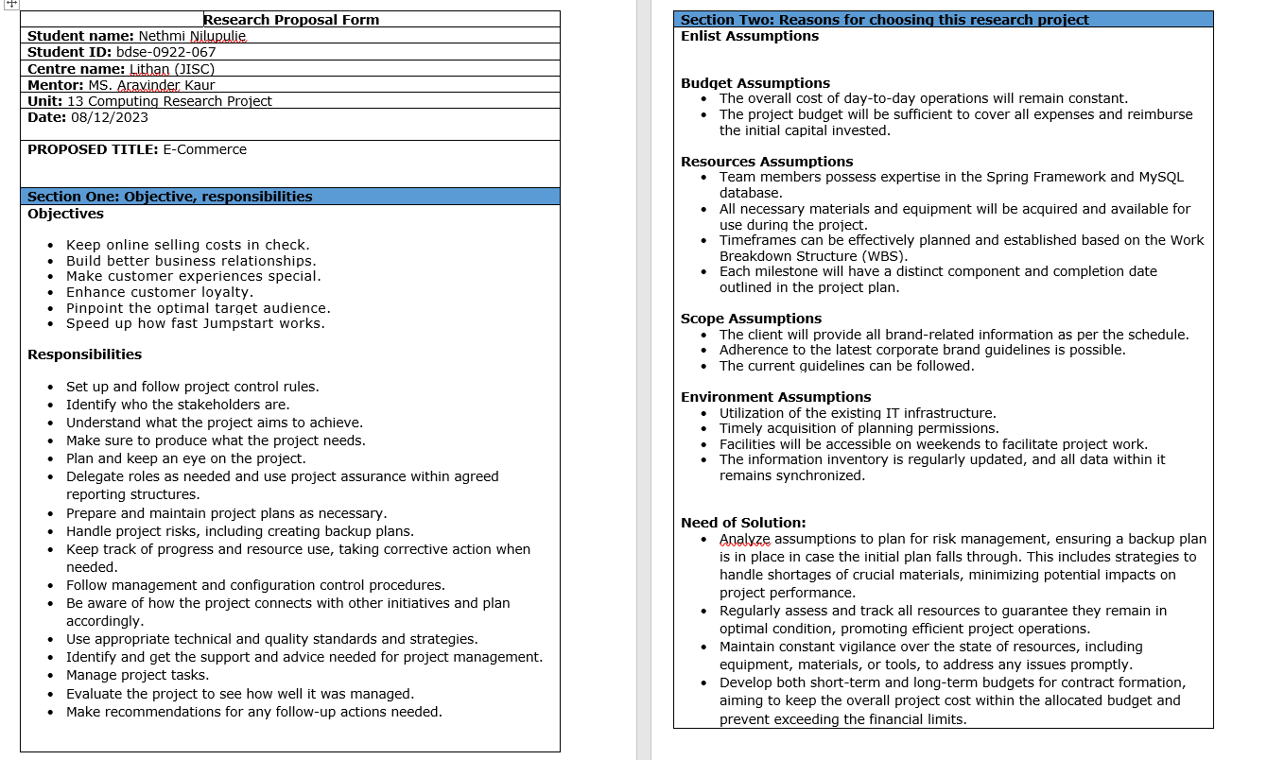
6. Research Proposal Template
2

Slide 17
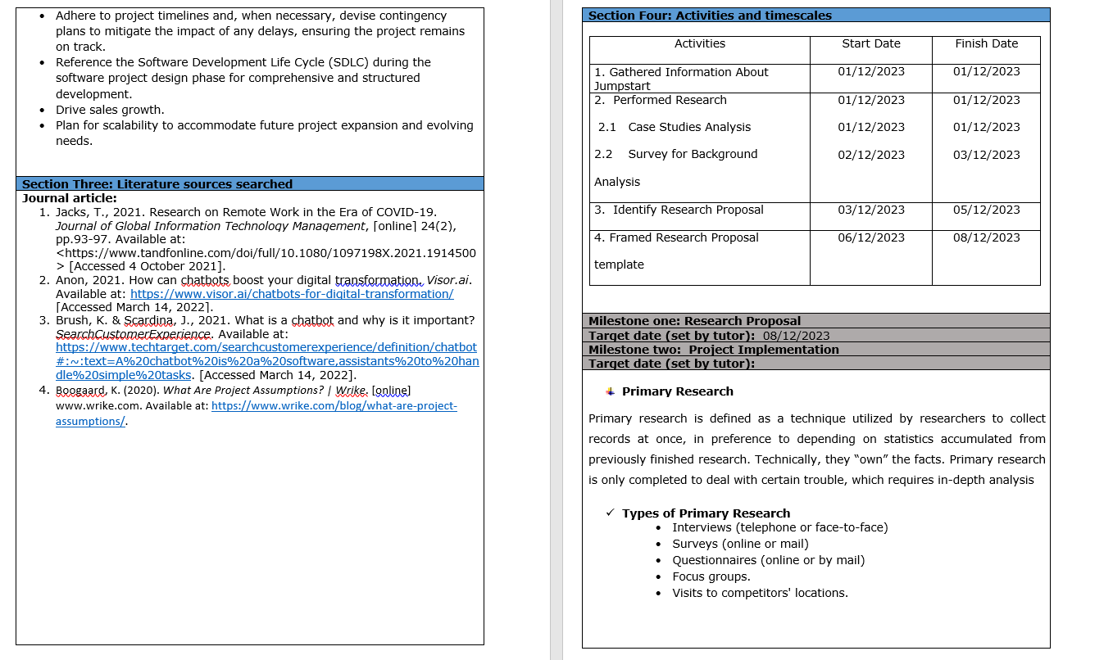
6. Research Proposal Template

Slide 18
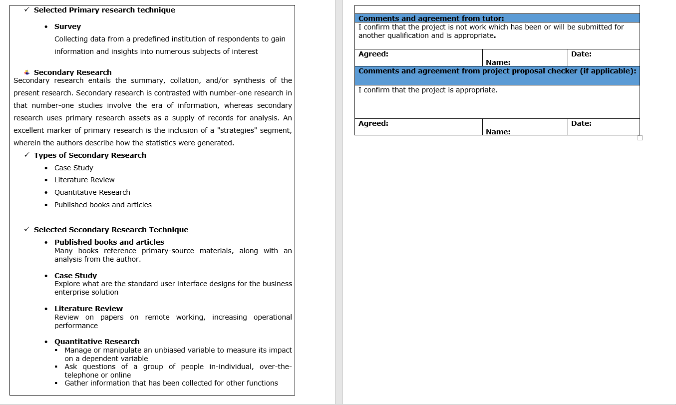
6. Research Proposal Template

Slide 19
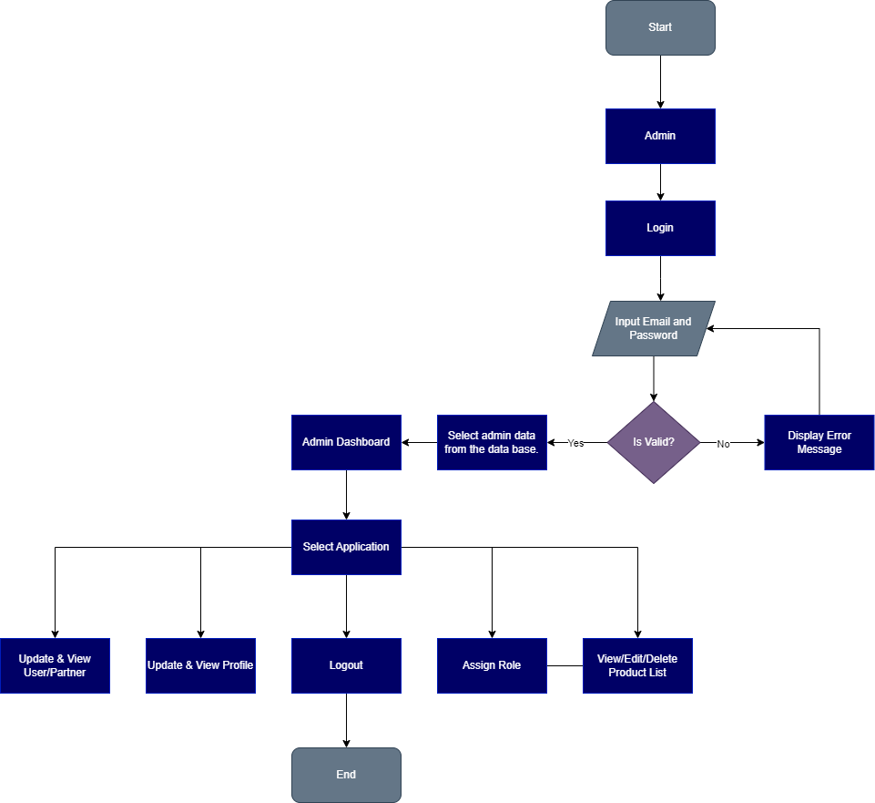
7. Project Design
Project Flowchart:
Admin

Slide 20
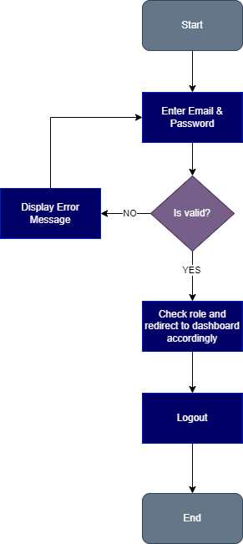
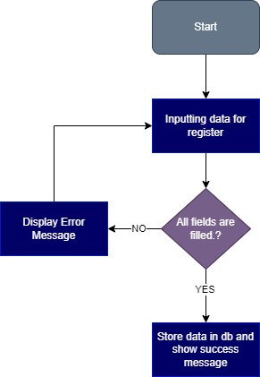
7. Project Design
Project Flowchart:
Login
Registration

Slide 21
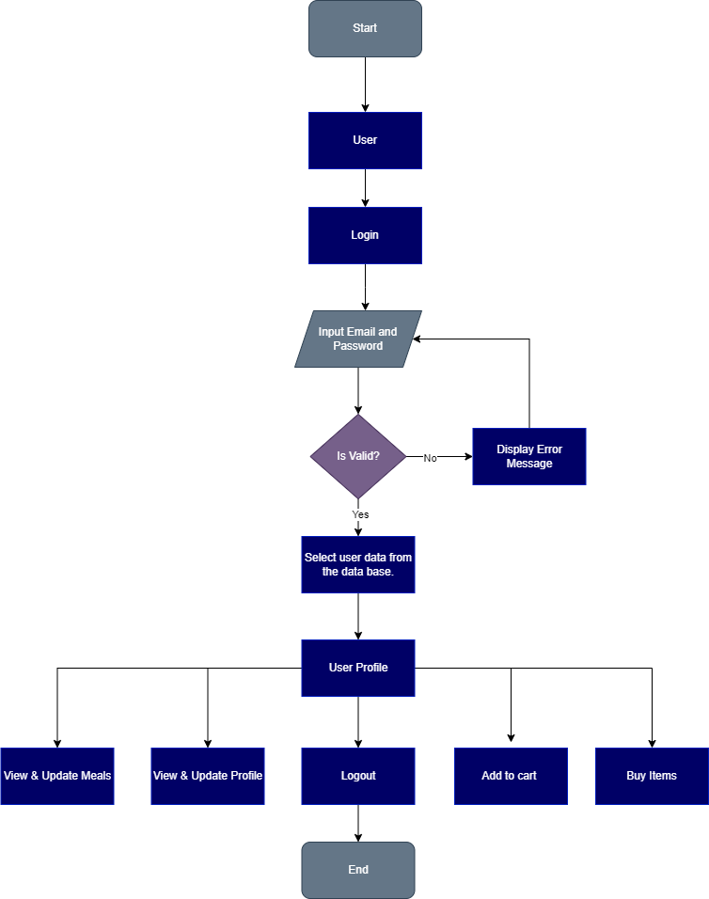
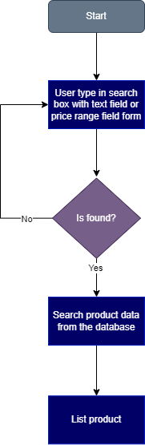
7. Project Design
Project Flowchart:
User
Search Products

Slide 22
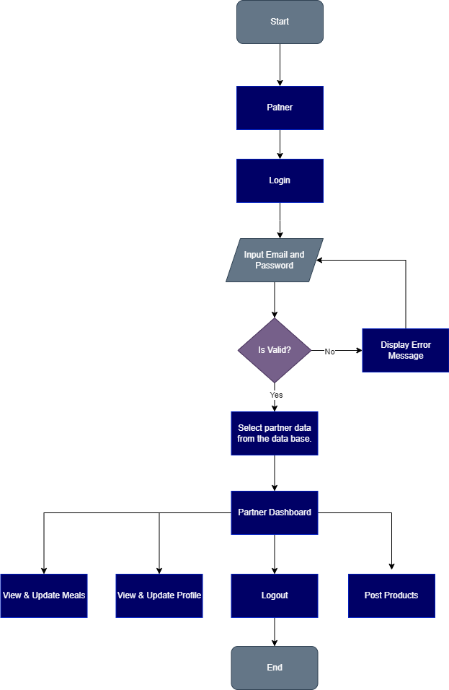
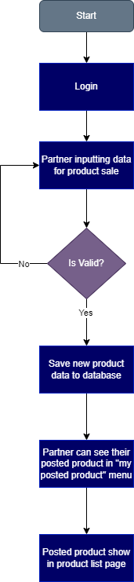
7. Project Design
Project Flowchart:
Partner
Post Products

Slide 23
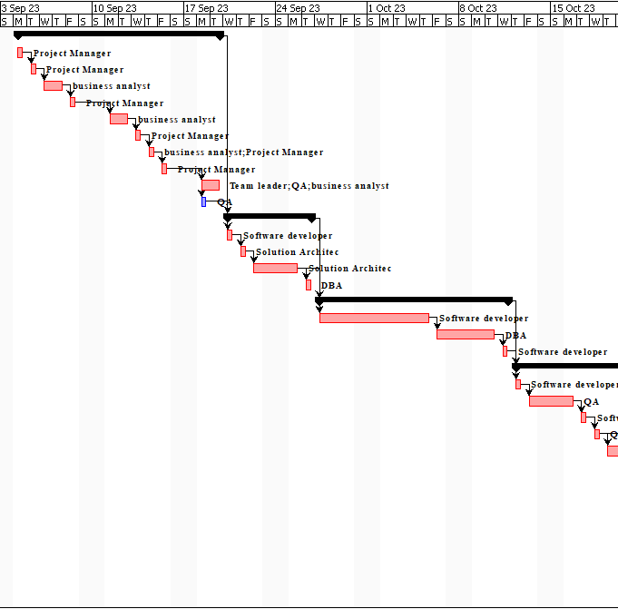
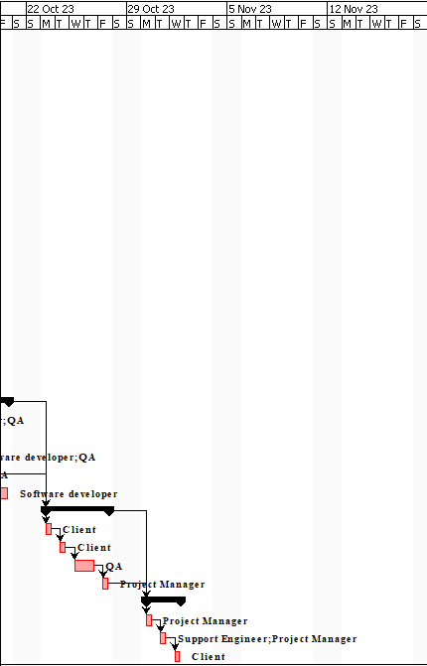
8. Project Gantt Chart

Slide 24
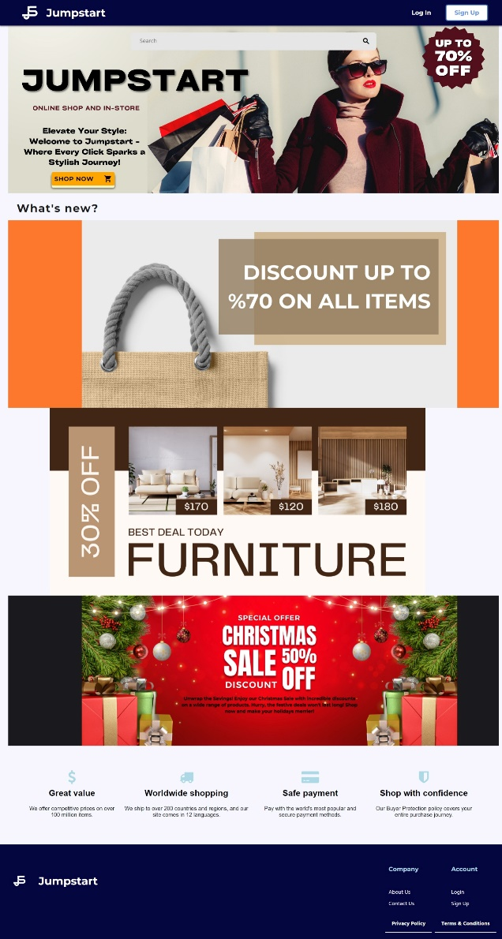
9. Project Execution
Screen Shots of Evidences: website results
Landing Page

Slide 25
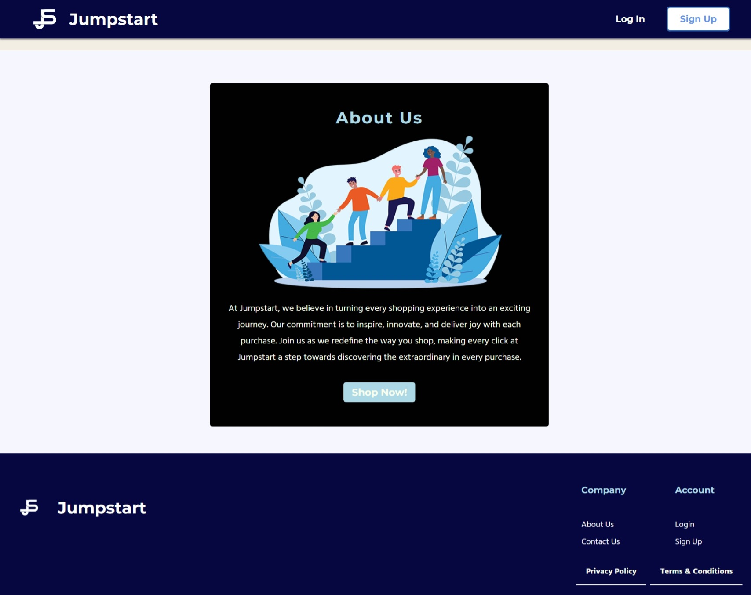
9. Project Execution
About Us Page

Slide 26
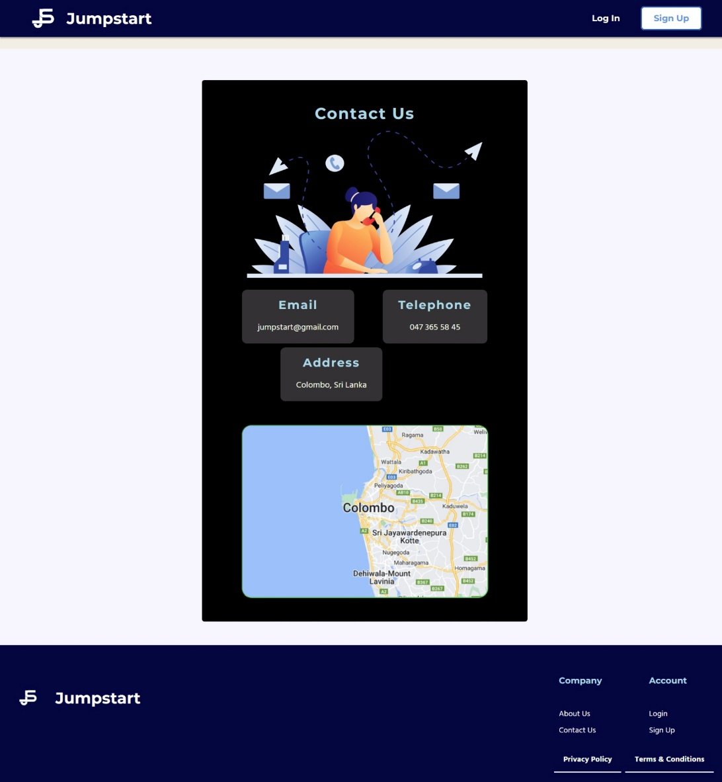
9. Project Execution
Contact Us Page

Slide 27
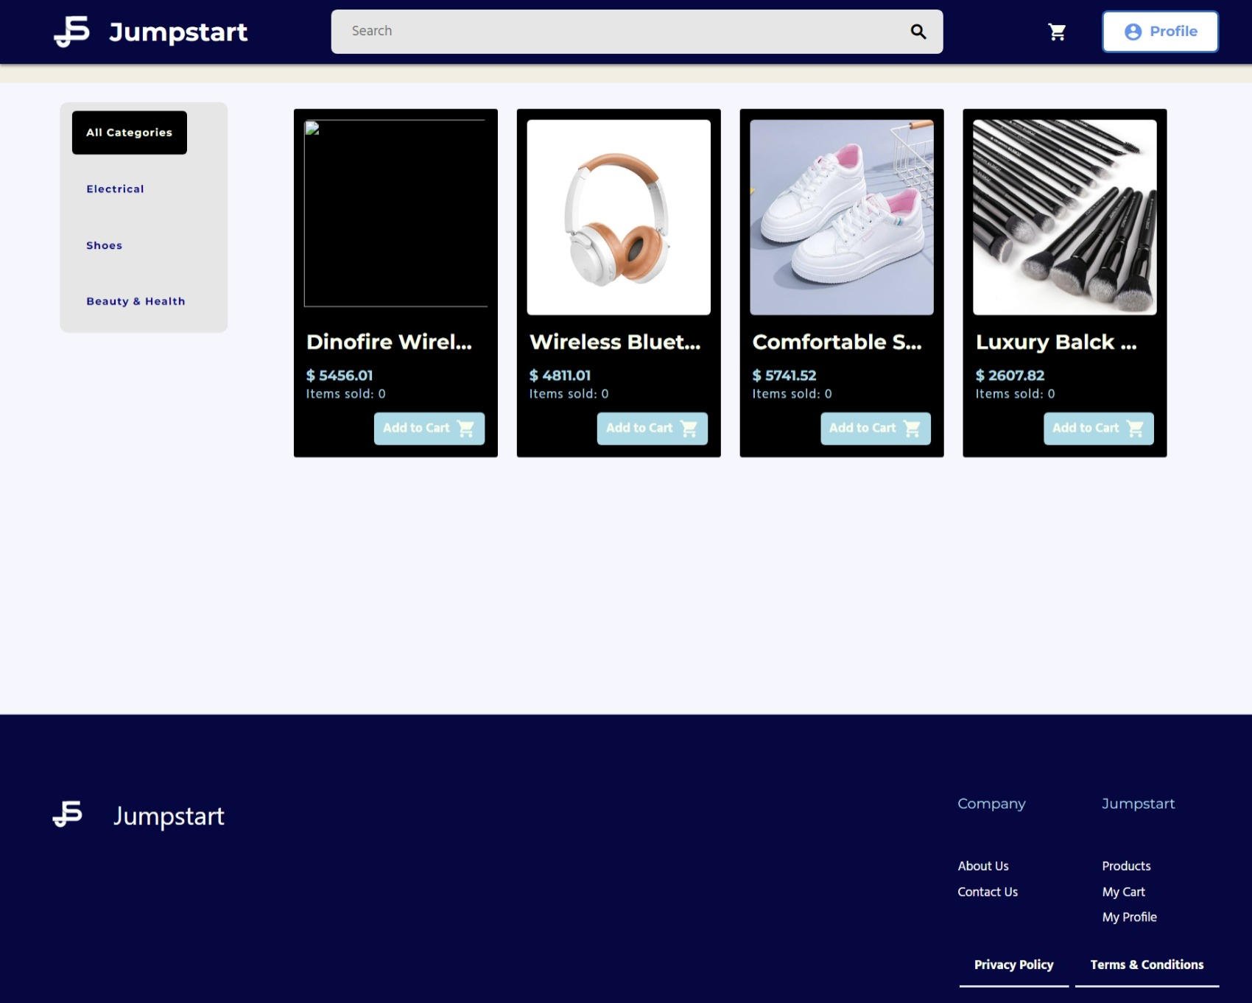
9. Project Execution
Product Page

Slide 28
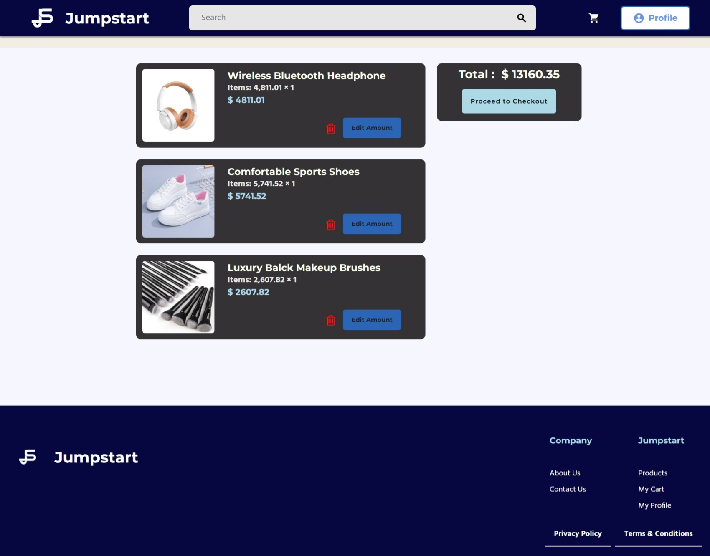
9. Project Execution
Order Product /
Order List

Slide 29
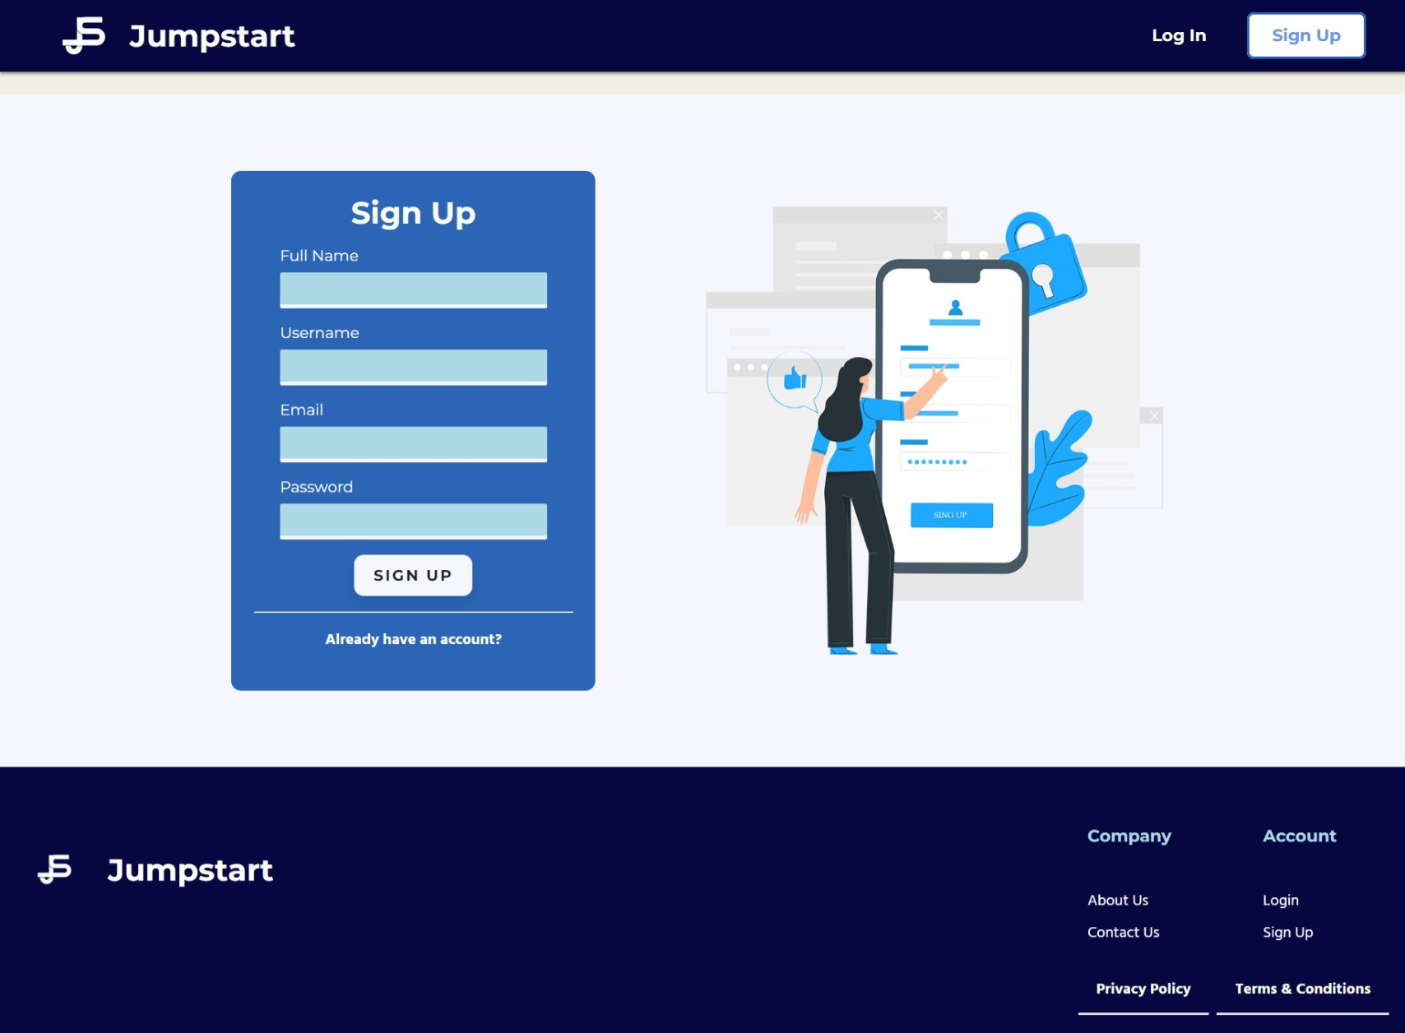
9. Project Execution
Registration Account

Slide 30
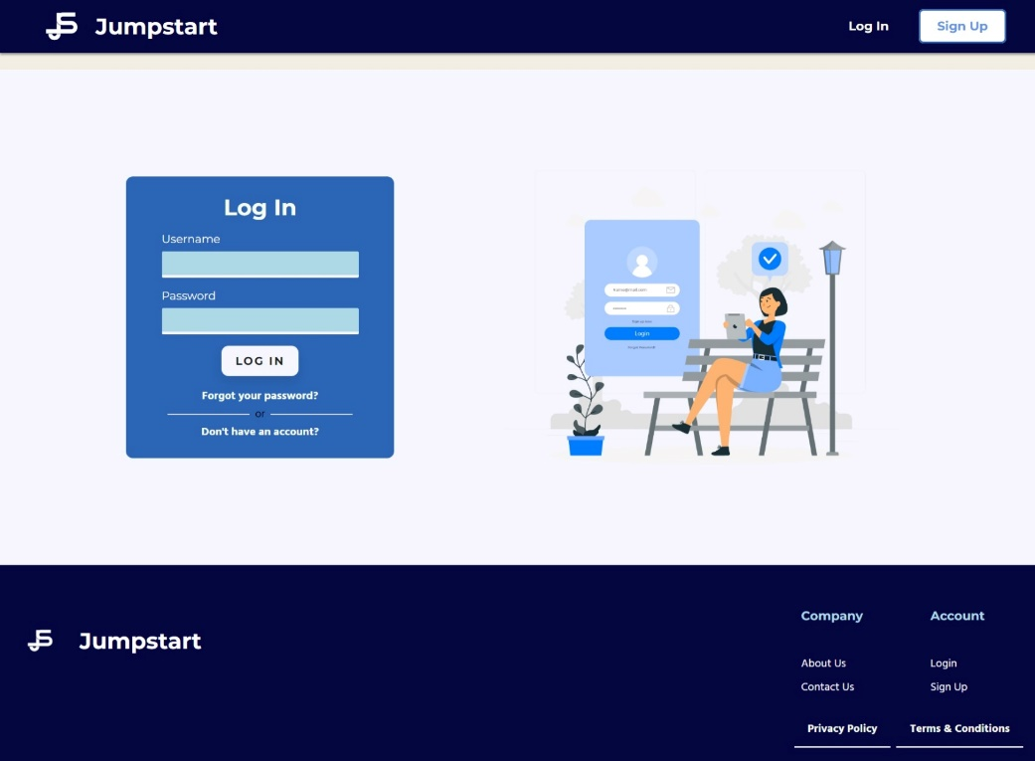
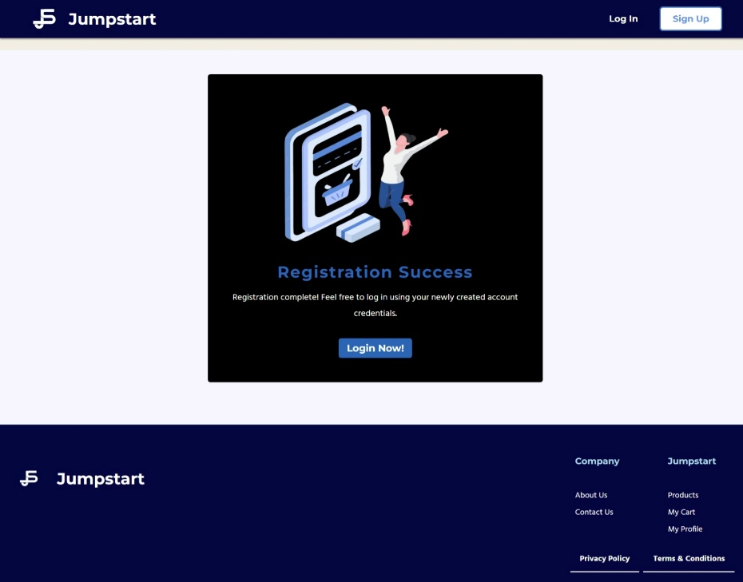
9. Project Execution
Login
Registration Thank You

Slide 31
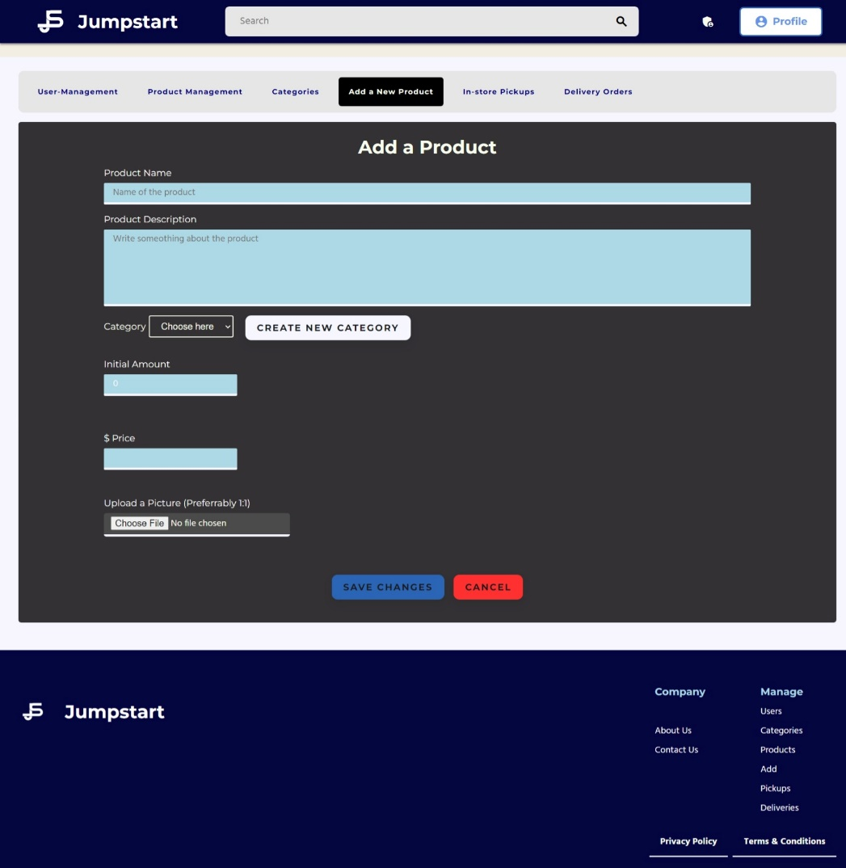

9. Project Execution
Post Products
Edit Profile

Slide 32

9. Project Execution
Profile

Slide 33


9. Project Execution
Cart Before Add Items
Cart After Add Items

Slide 34


9. Project Execution
Admin Dashboard
Product Management

Slide 35
10. Milestone Feedback & Action taken
Project Milestone ID | Milestone Feedback received from Tutor / Learning Facilitator | Action Taken (Yes / No)
1 | Create survey | Yes
 | Change time periods of Gantt chart | Yes
 | Create product management list | Yes
2 | Add location to contact us page | Yes
 | Add more details to home page | Yes
 | Connect Database | Yes
3 |  | Yes
 |  | Yes
 |  | Yes

Slide 36
11. Proposed Improvements
Future Recommendation:
Creating more better code and not repeating that can be reused
Consistent with the naming convention
Implement other functionalities
Create chat feature with the partner and the user to get delivery, items condition details

